Slide 1

Admond Lee
Artificial Neural Network
For Beginners
Notes:
Ask students to briefly introduce themselves:
Name, course, year of study etc.
What brought them here to the workshop today?

Slide 2



Admond Lee
Little Bit About Me
Physics in NTU
Data Scientist

Slide 3






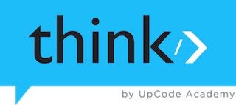
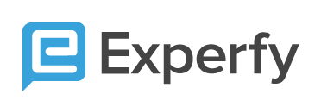
Data Science Writer
Notes:
Document my journey, share my experience and learn from others
Help and guide aspiring data scientists and enthusiasts
Improve my communication skills

Slide 4

Data Science Consulting
Helping digital marketing agencies and companies solve problems using data
Data Science Consulting
Web Analytics
Attribution Modelling
Deep Learning / ML
Advanced Social Analytics

Slide 5
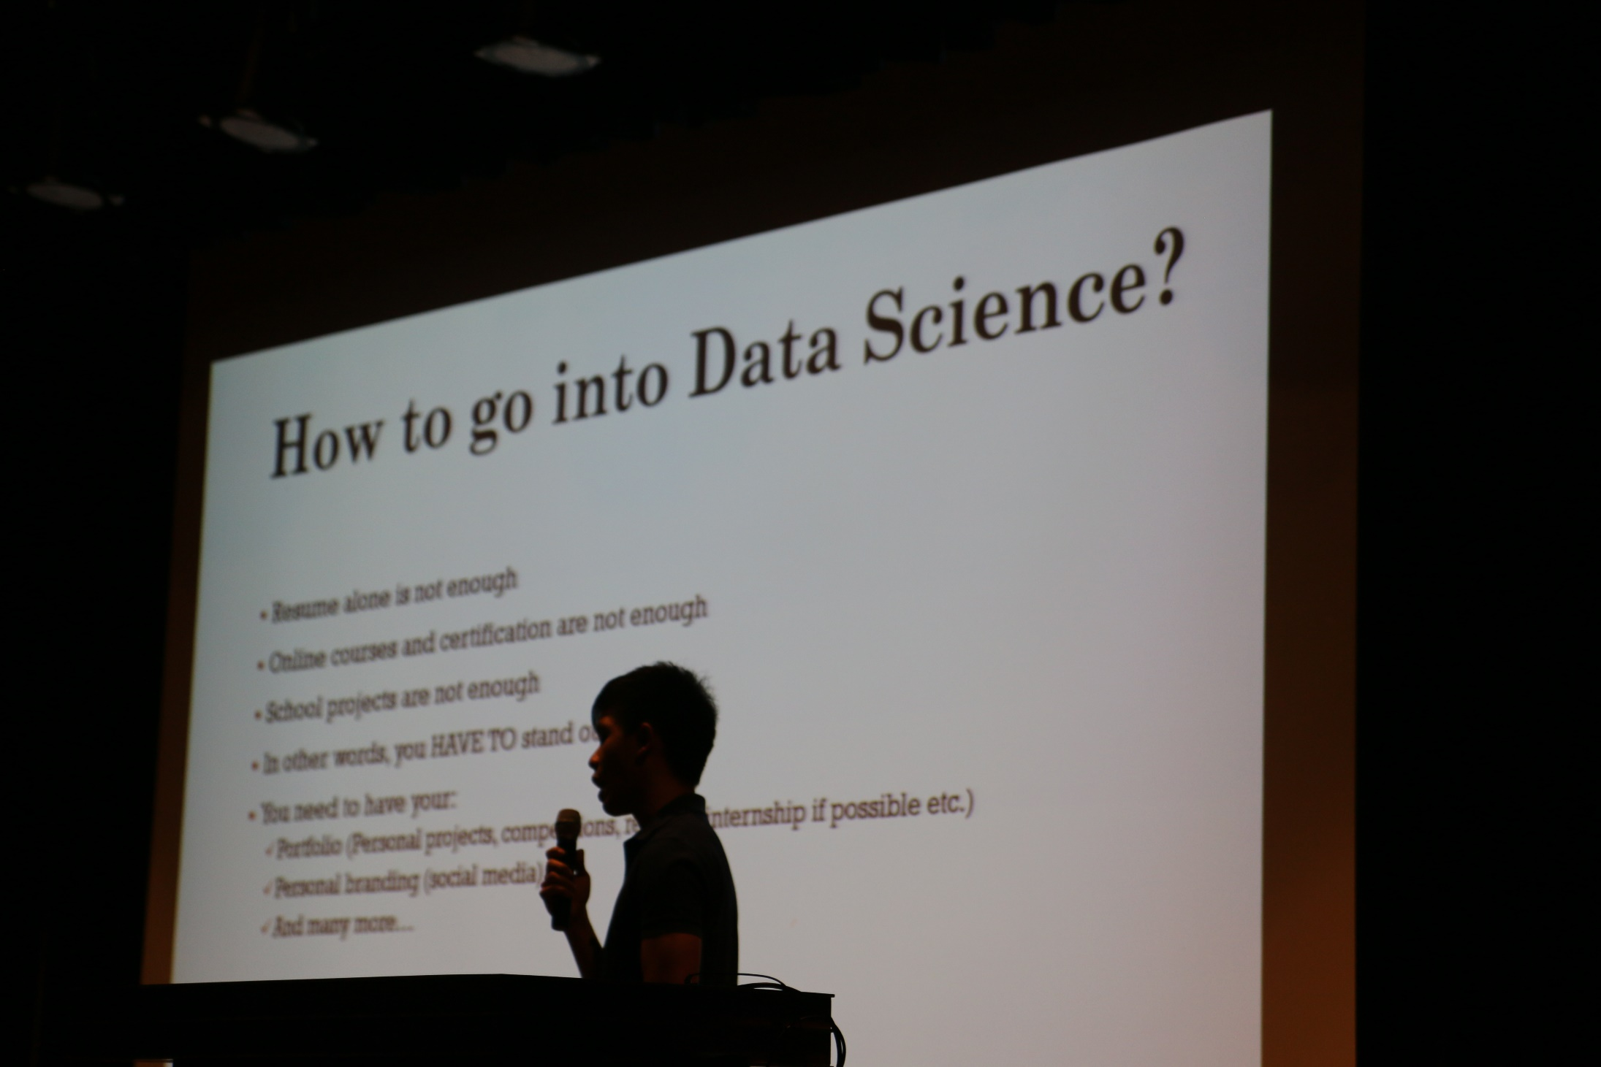
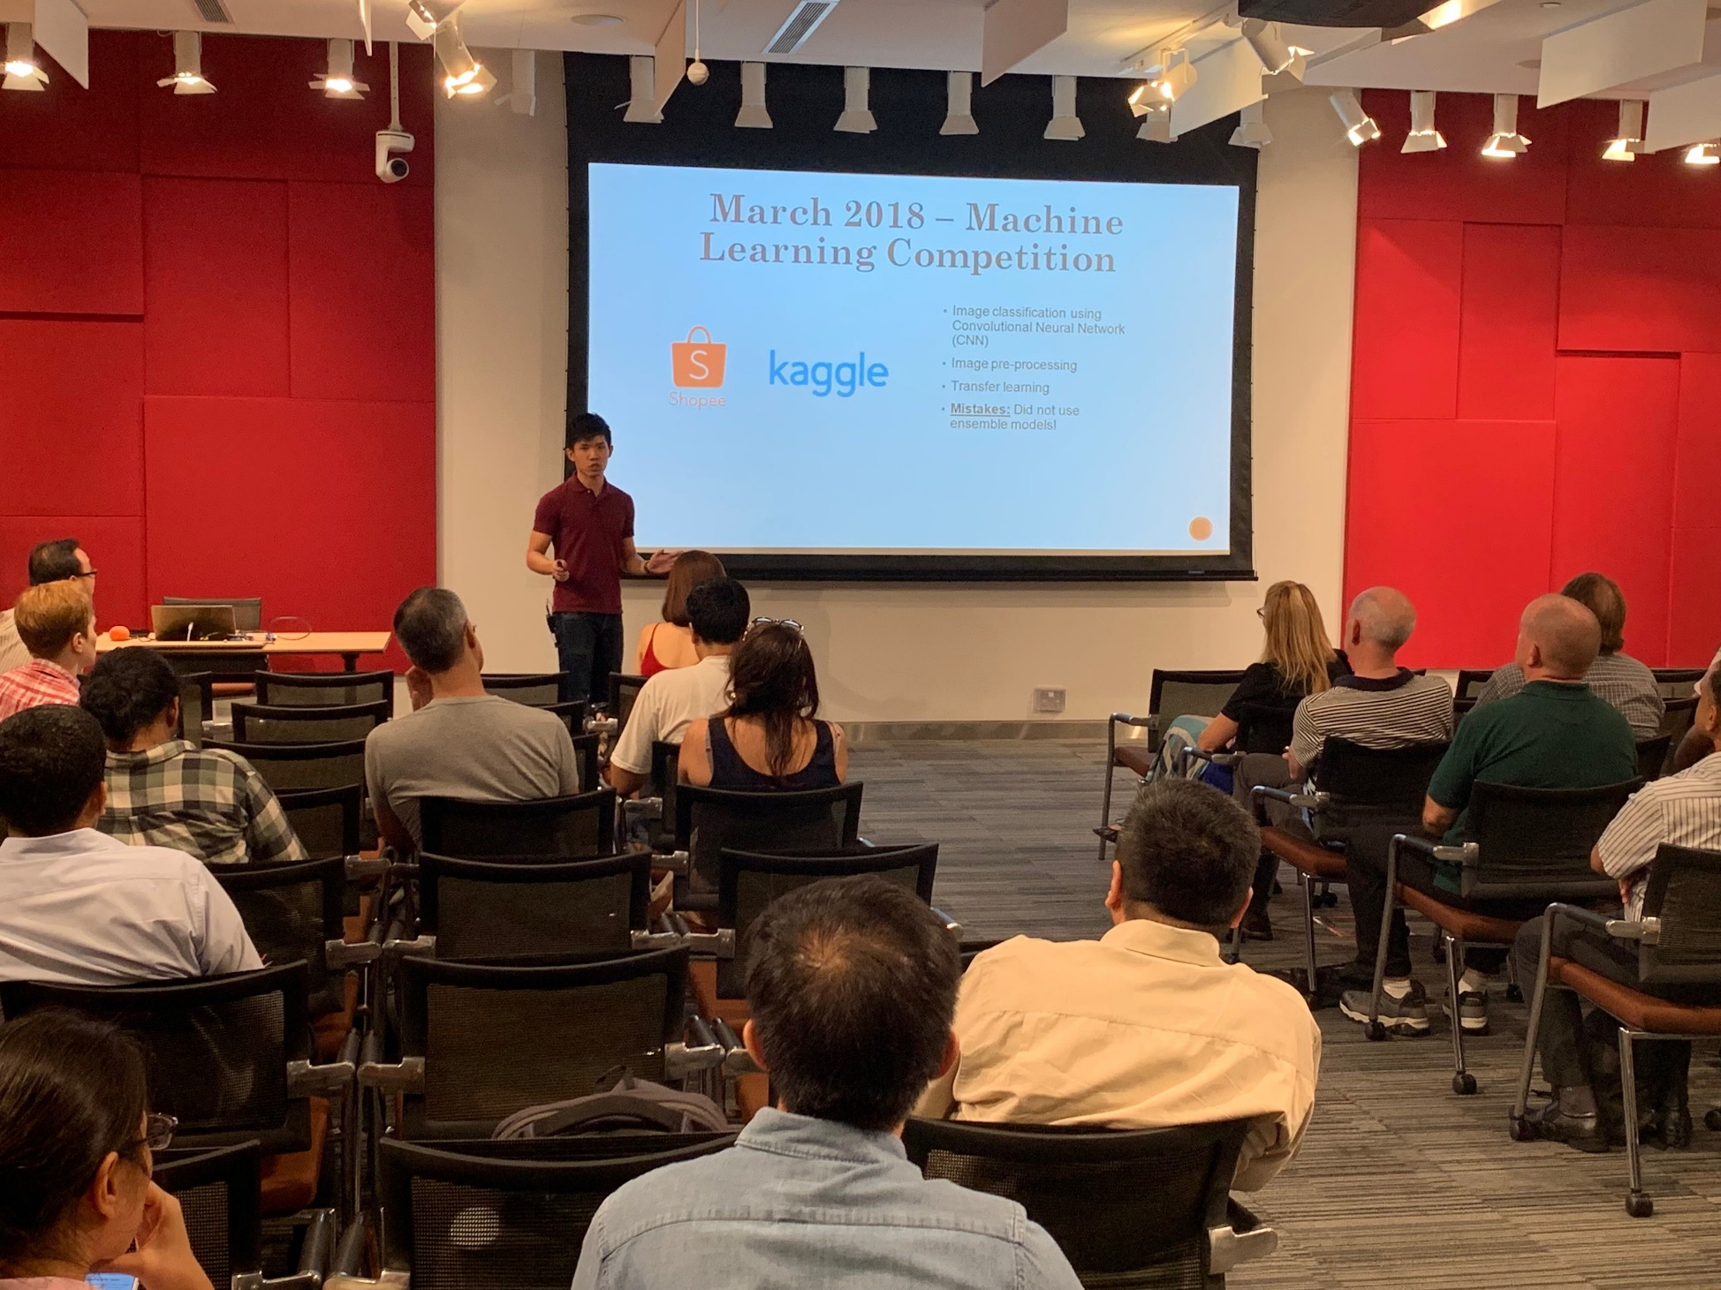
Data Science Communicator

Slide 6

What We’ll Cover Today
What is Artificial
Neural Network?
Build a simple ANN model
(for real)
Notes:
Agenda – Explain the goal of each section

Slide 7

What is Artificial Neural Network?

Slide 8
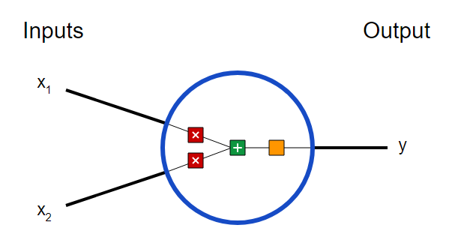
Fundamental Building Blocks – Neurons
Neuron
A neuron takes inputs, does some math with them, and produces one output

Slide 9
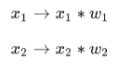
Fundamental Building Blocks – Neurons
weight
The higher the weight:
The faster it will trigger the activation function
The more impact it will have on the network

Slide 10
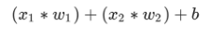
Fundamental Building Blocks – Neurons
Bias is used to delay the triggering of the activation function
bias

Slide 11
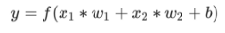
Fundamental Building Blocks – Neurons
Activation function

Slide 12
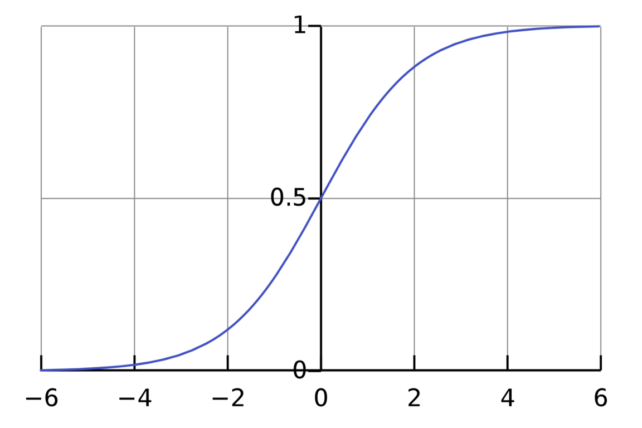
Activation Function
An activation function is used to turn an unbounded input into an output that has a nice, predictable form
It will decide whether a neuron should fire or not
Sigmoid function

Slide 13
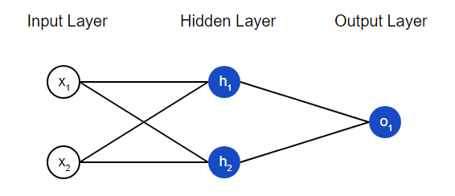
Neural Network
A neural network is nothing more than a bunch of neurons connected together
A neural network can have any number of layers with any number of neurons in those layers
Feedforward Neural Network

Slide 14
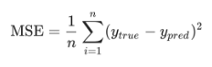
Training a Neural Network
Minimize the error (or loss) from predictions
Lower loss → Better predictions
Mean Squared Error (MSE) →
(Loss function)
Compare the actual and predicted values
Compute loss function to find the error

Slide 15
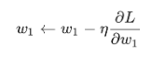
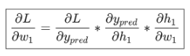
Backpropagation
AIM – Update the network’s weights and biases to minimize the error from predictions
Lower loss → Better predictions
Mean Squared Error (MSE) →
(Loss function)
How to know which weights to be updated
Partial derivative
This system of calculating partial derivatives by working backwards is known as backpropagation

Slide 16

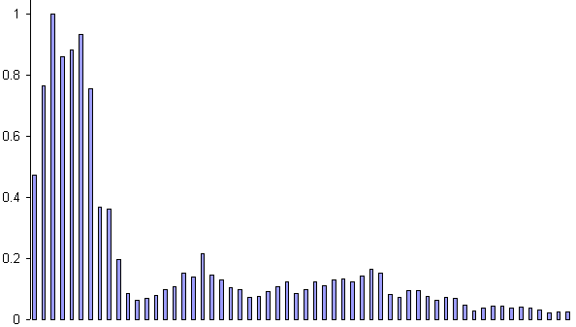
Example – Voice Recognition
Task
Learn to discriminate between two different voices saying “Hello”
Data
Sources
Steve
David
Format
Frequency distribution (60 bins)

Slide 17
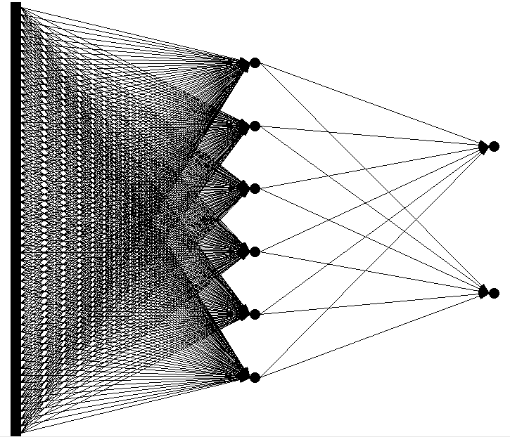
Network architecture
Feedforward network
60 input (one for each frequency bin)
6 hidden
2 output (0-1 for “Steve”, 1-0 for “David”)

Slide 18
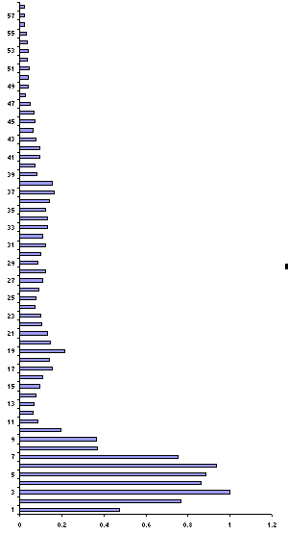
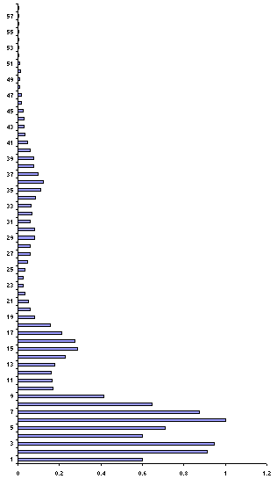
Presenting the data
Steve
David

Slide 19
Presenting the data (untrained network)
0.43
Steve
0.26
0.73
David
0.55

Slide 20
Calculate error
0.43 – 0 = 0.43
Steve
0.26 – 1 = 0.74
0.73 – 1 = 0.27
David
0.55 – 0 = 0.55

Slide 21
Backpropagate error and adjust weights
0.43 – 0 = 0.43
Steve
0.26 – 1 = 0.74
1.17
0.73 – 1 = 0.27
David
0.55 – 0 = 0.55
0.82

Slide 22
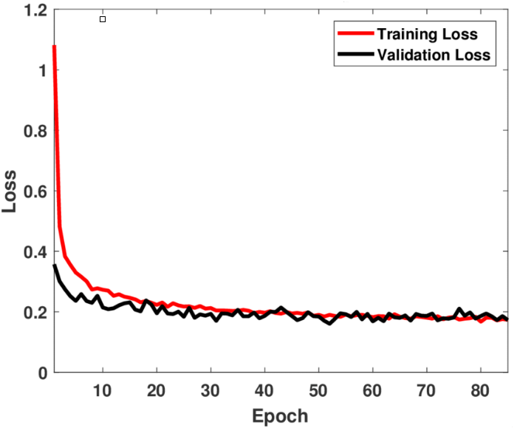
Example – Voice Recognition
Repeat process (sweep) for all training pairs
Present data
Calculate error
Backpropagate error
Adjust weights
Repeat process multiple times

Slide 23
Presenting the data (trained network)
0.01
Steve
0.99
0.99
David
0.01

Slide 24
Neural Network Demo
http://playground.tensorflow.org

Slide 25
Introduction to Keras

Slide 26
What is Keras?
Keras is a high-level deep learning API written in Python that can run on top of the deep learning libraries (TensorFlow, CNTK, Theano etc.)
Python deep learning library
Basically an API “designed for human beings, not machines”
TensorFlow is an open-source deep learning library developed by Google
When TensorFlow 2.0 was released in late 2019, it adopted Keras as the official API for TensorFlow 2.0
Can import Keras directly from TensorFlow library

Slide 27
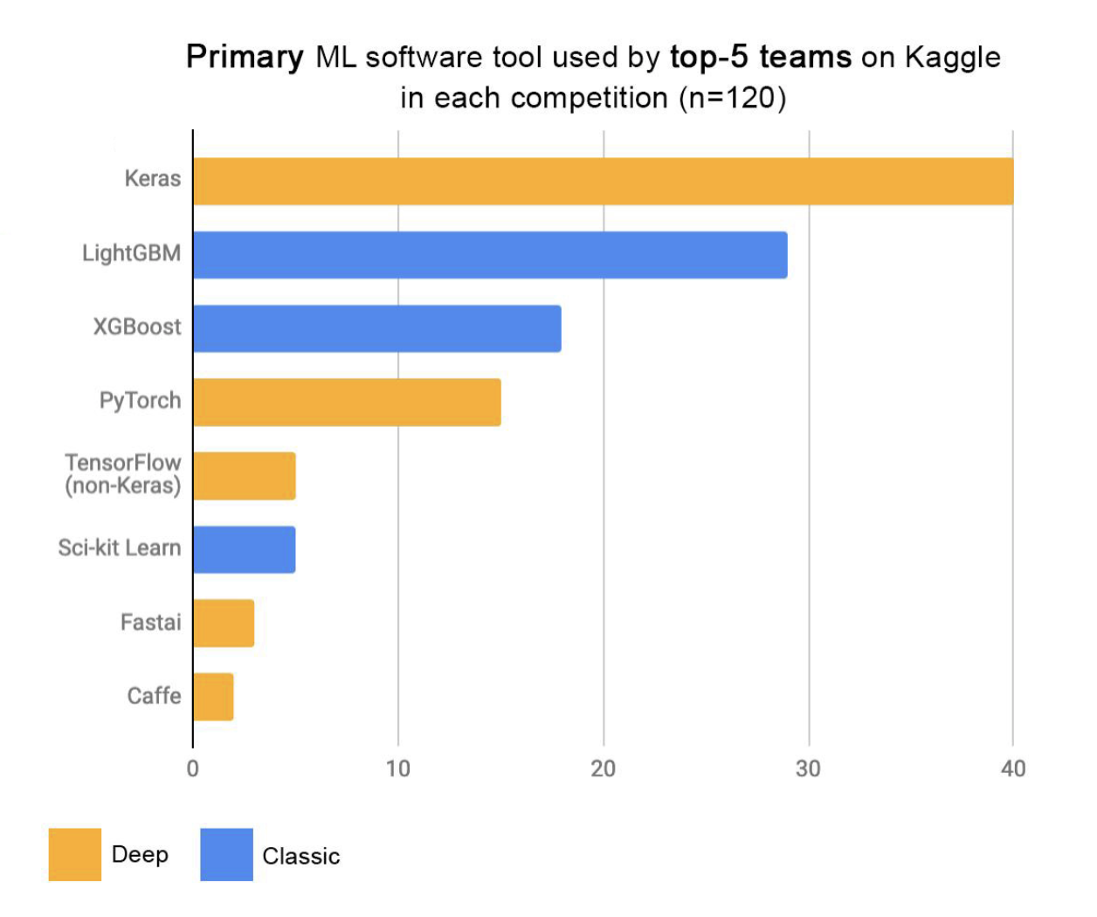
Why Keras?
Easy to use as it provides simple APIs to build deep learning models
Provide clear & actionable error messages
Easy to test new ideas, build prototype models, and deploy to production
Strong multi-GPU & distributed training support
Broad adoption in the industry and the research community
Year: 2019

Slide 28
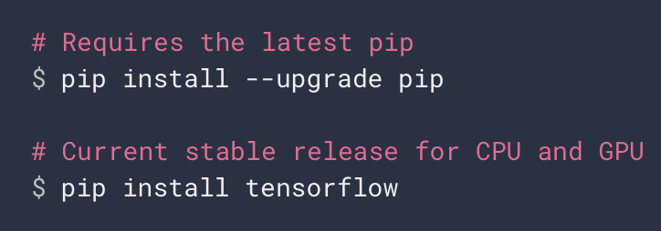
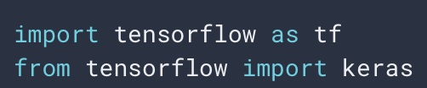
How to get Keras?
Install TensorFlow
Import Keras

Slide 29

Let’s use Keras to build a simple ANN model and see how it works
Notes:
Go to my Jupyter notebook to show pre-run code and explain its implementation to build a simple ANN mode

Slide 30

Let’s Connect!
bit.ly/admond-linkedin
bit.ly/admond-medium
bit.ly/admond-twitter
bit.ly/admond-instagram
bit.ly/admond-website
Notes:
What’s next?

Slide 31
THANK YOU!

Slide 32




